Slide 1
EXPLAINING AND HARNESSING ADVERSARIAL EXAMPLES
12191656 이채연
Ian J. Goodfellow

Slide 2
CONTENTS
INTRODUCTION
THE LINEAR EXPLANATION OF ADVERSARIAL EXAMPLES
LINEAR PERTURBATION OF NON-LINEAR MODELS - FGSM
ADVERSARIAL TRAINING OF LINEAR MODELS
ADVERSARIAL TRAINING OF DEEP NETWORKS
DIFFERENT KINDS OF MODEL CAPACITY – RBF networks

Slide 3
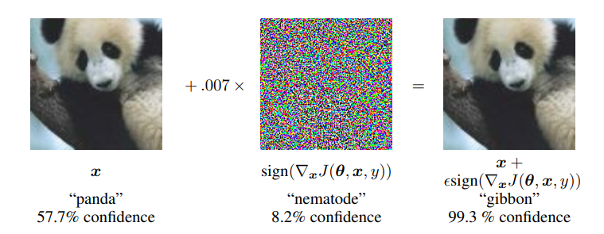
INTRODUCTION
Adversarial examples
inputs formed by applying small but intentionally perturbations to examples
results in the model outputting an incorrect answer with high confidence

Slide 4

INTRODUCTION
Adversarial examples
Szegedy et al. (2014b) made an intriguing discovery: several machine learning models are vulnerable to adversarial examples.
Previous research : Maybe the cause of these adversarial examples is due to extreme nonlinearity of deep neural networks, insufficient regularization and overfitting.
Ian Goodfellow : It’s because of their linear nature.

Slide 5

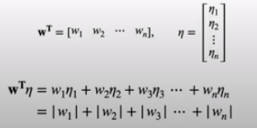

THE LINEAR EXPLANATION OF ADVERSARIAL EXAMPLES
Ex. Pixel [1,255] / epsilon = 0.3
Hypothesis H(x) = Wx
Adversarial input
Assigning
every element of the perturbation η
is smaller than the precision of the features.
the activation grow by
η can grow linearly with n.
(Epsilon, m : average magnitude of w, n : dimensions)
‘A simple linear model can have adversarial examples if its input has sufficient dimensionality.’

Slide 6
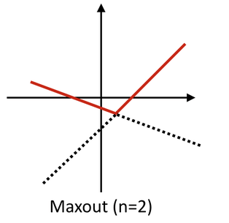
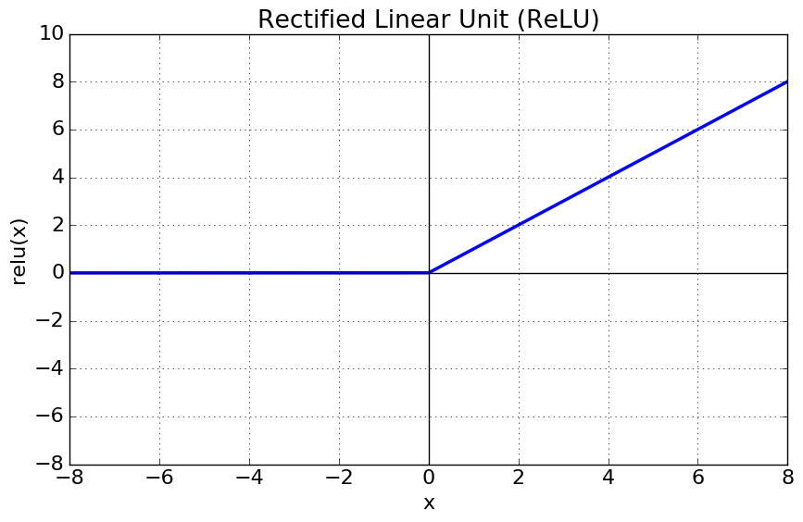
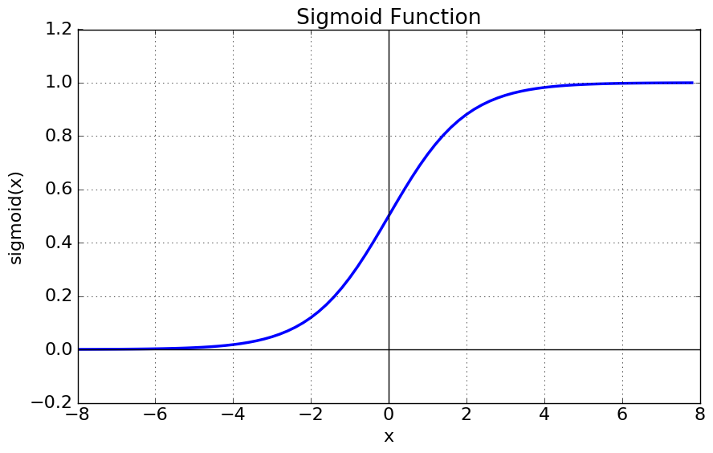
LINEAR PERTURBATION OF NON-LINEAR MODELS - FGSM
Nonlinear model’s linear behavior
They hypothesize that neural networks are too linear to resist linear adversarial perturbation.
LSTMs, ReLUs, maxout networks, and sigmoid networks are all intentionally designed to behave in very linear ways.
This linear behavior suggests that perturbations of a linear model should also damage neural networks.

Slide 7
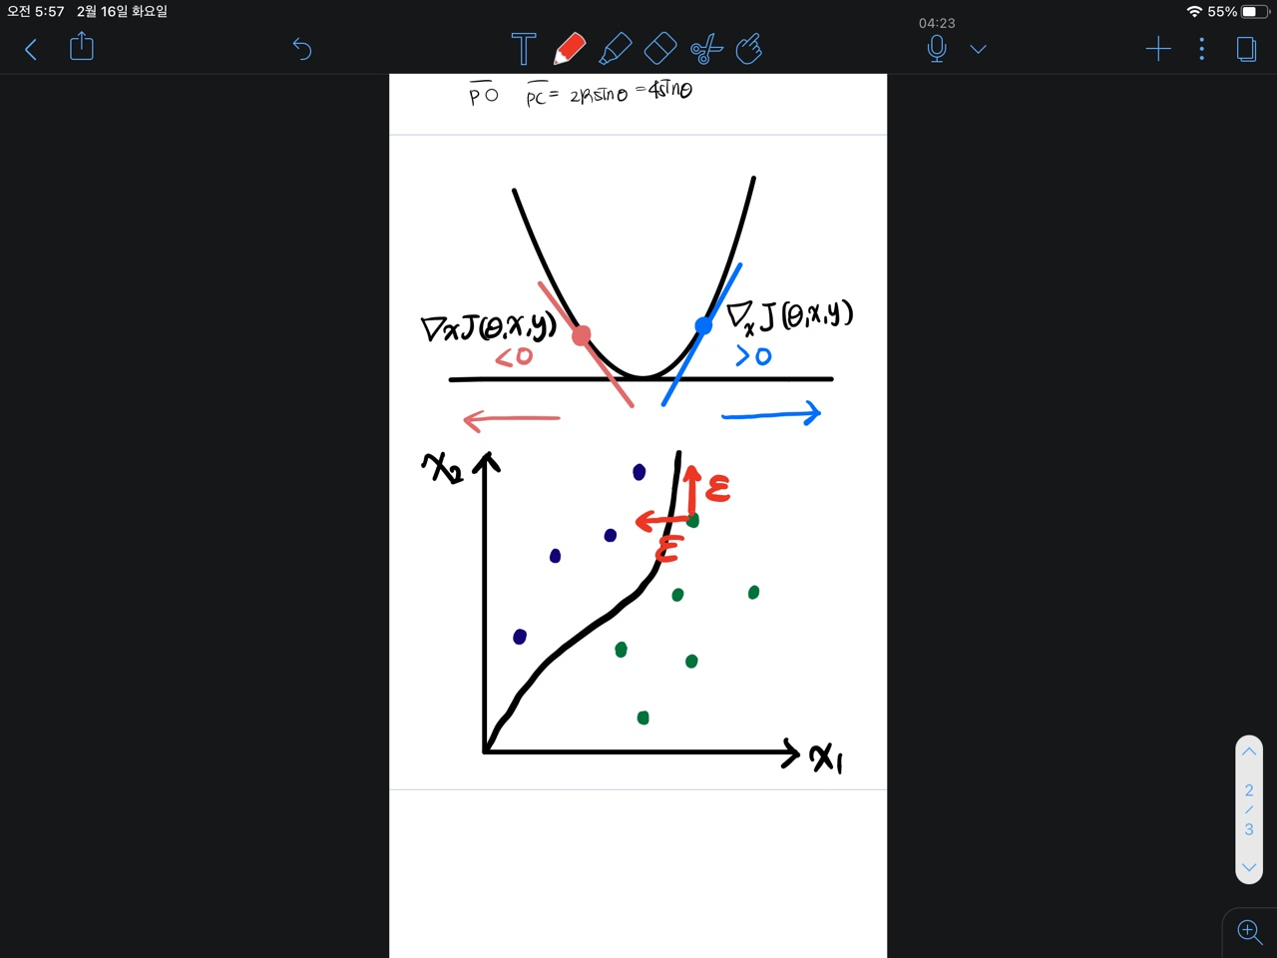
INTRODUCTION
Generating adversarial examples – Fast Gradient Sign Method
θ : parameters of a model, x : input to the model, y : the targets
J(θ, x, y) : cost function used to train the neural network.
obtaining an optimal max-norm constrained perturbation
Adversarial Input

Slide 8
INTRODUCTION
Generating adversarial examples – Fast Gradient Sign Method
FGSM method reliably causes a wide variety of models to misclassify their input.
Test set | epsilon | network | Error rate | confidence
MNIST | 0.25 | Shallow softmax | 99.9% | 79.3%
MNIST | 0.25 | Maxout network | 89.4% | 97.6%
CIFAR-10 | 0.1 | Convolutional maxout network | 87.15% | 96.6%

Slide 9
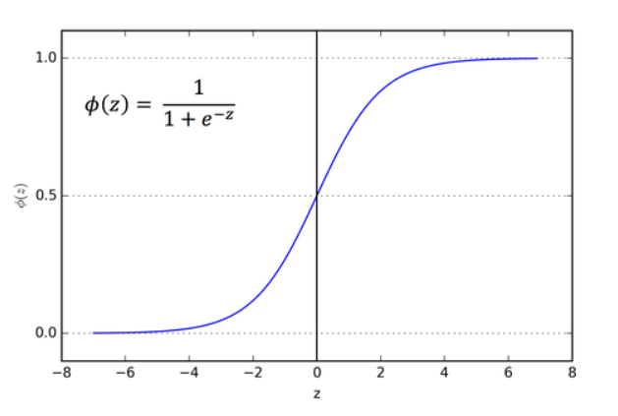

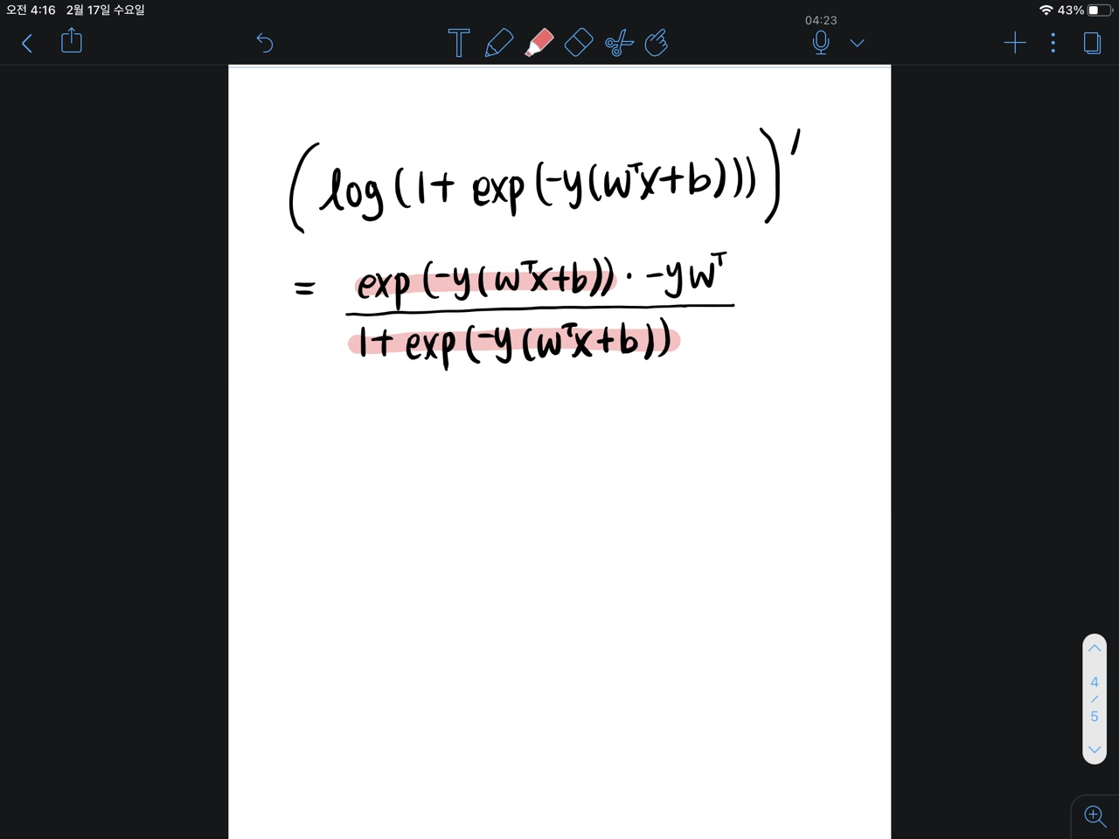
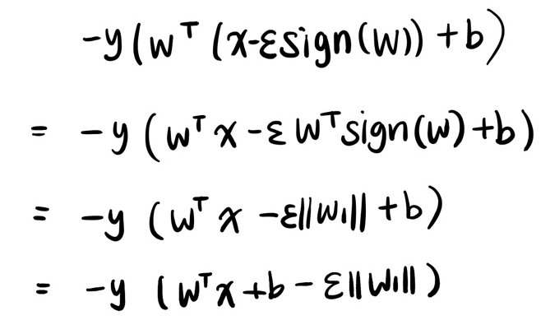

ADVERSARIAL TRAINING OF LINEAR MODELS
Logistic sigmoid function
Logistic regression
Loss function
Soft plus function
Gradient descent on loss function
The adversarial version of
logistic regression
Sign of the gradient is –sign(w)

Slide 10

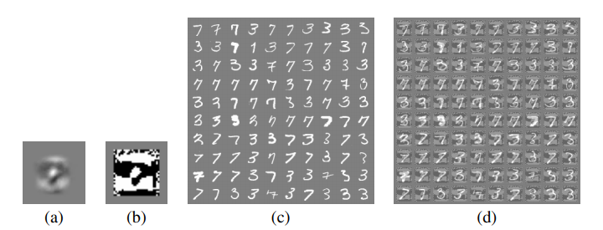
ADVERSARIAL TRAINING OF LINEAR MODELS VERSUS WEIGHT DECAY
Adversarial version of logistic regression
a) weights of a logistic regression
on MNIST
b) sign of weights
c) MNIST 3s & 7s -> error rate 1.6%
d) adversarial examples(FGSM) for model
(epsilon = 0.25) -> error rate 99%

Slide 11
ADVERSARIAL TRAINING OF DEEP NETWORKS
An adversarial objective function based on the fast gradient sign method
1) The model was an effective regularizer.
α = 0.5, a Maxout network that was regularized with dropout
without adversarial training : error rate 0.94%
with adversarial training : error rate 0.84%

Slide 12
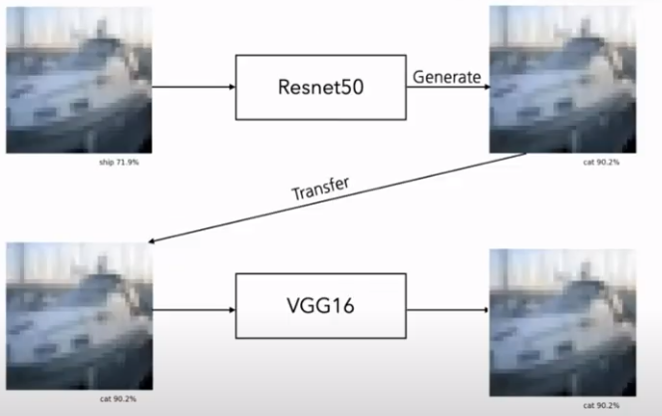
ADVERSARIAL TRAINING OF DEEP NETWORKS
2) The model became resistant to adversarial examples.
Same model , input : adversarial examples
without adversarial training : error rate 89.4%
with adversarial training : error rate 17.9%
3) Adversarial examples are transferable.
Adversarial examples generated via the original model yield an error rate of 19.6% on the adversarially trained model
Adversarial examples generated via the new model yield an error rate of 40.9% on the original model.
New model
original model

Slide 13
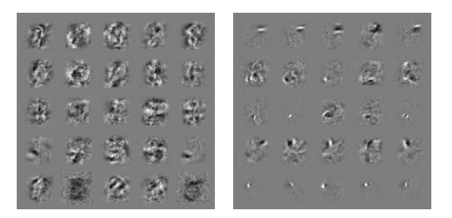
ADVERSARIAL TRAINING OF DEEP NETWORKS
4) When the adversarially trained model does misclassify an adversarial example, its predictions are unfortunately still highly confident.
The average confidence on a misclassified example was 81.4%.
5) The weights of the adversarially trained model being significantly more localized and interpretable.
Left) Model without adversarial training
Right) Model with adversarial training

Slide 14
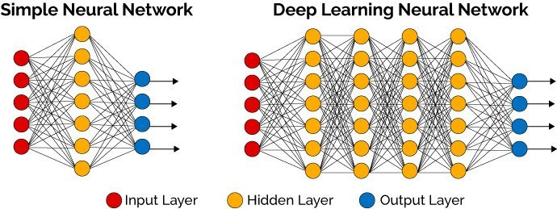
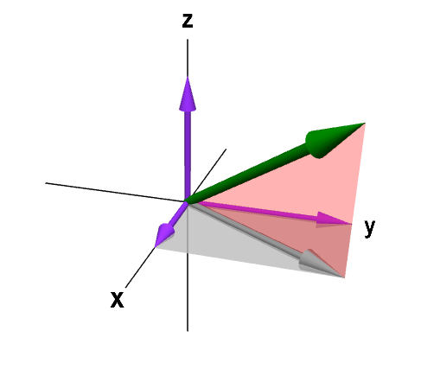
DIFFERENT KINDS OF MODEL CAPACITY – RBF networks
Models : high dimensional space
Human live in three dimensions
Some models with low capacity are immune to adversarial examples.
A shallow RBF network with no hidden layers
Input : adversarial examples(FGSM)
Data set : MNIST
epsilon : 0.25
Error rate 55.4%
Confidence on mistaken examples 1.2%
Confidence on clean test examples 60.6%

Slide 15
Thank you

